Slide 1

Benefits of
.....Drinkable Oats.....
Oct 2021 Matt Beyer

Slide 2
Aerodynamics of an Airplane ‘Stall’
Oct 2021 Matt Beyer

Slide 3
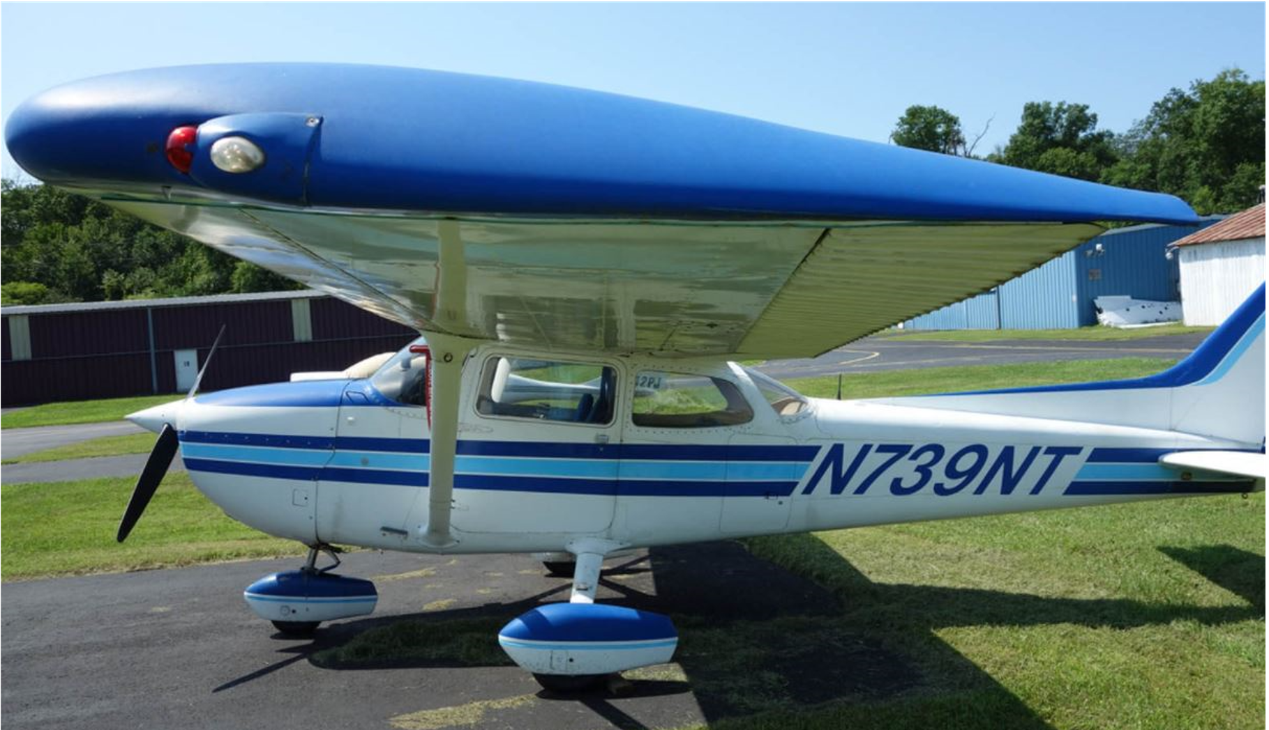

What is an ‘Aerodynamic Stall’
Definition
  A ‘Stall’ is defined as: “a sudden reduction in the lift generated by an aerofoil when the critical angle of attack is reached or exceeded.”
  Lift is significantly reduced, Drag is significantly increased

Slide 4
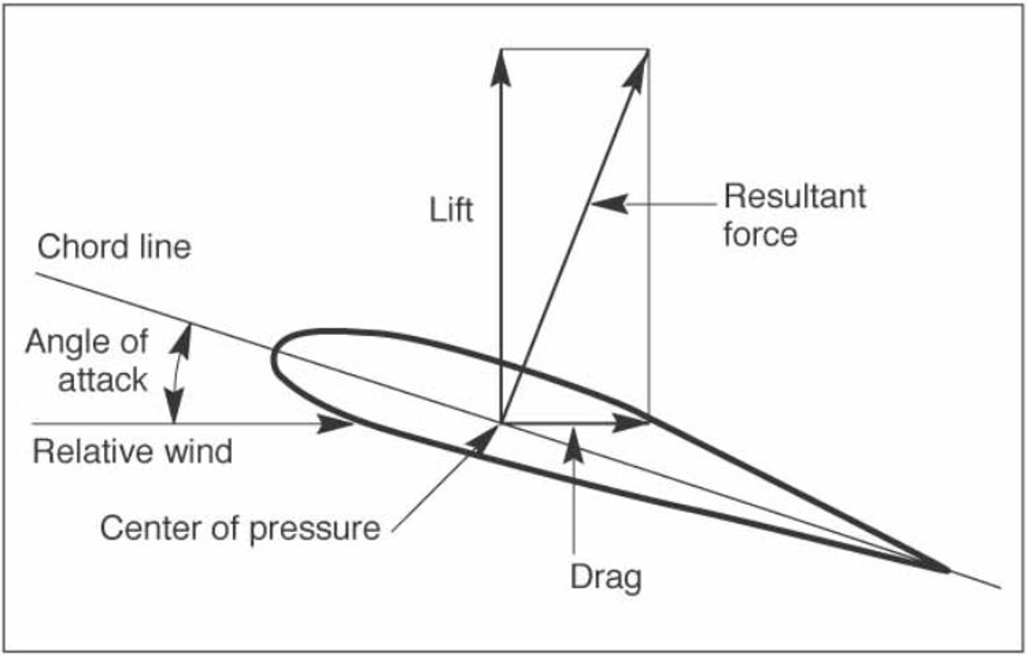
Terms/Phrases
Definition of Terms
  Cord Line,
  Relative Wind,
  Angle of Attack (AOA)
  Critical angle of attack
    AOA > ~18degrees
Reminder: A stall occurs when the AOA exceeds the critical angle of attack

Slide 5
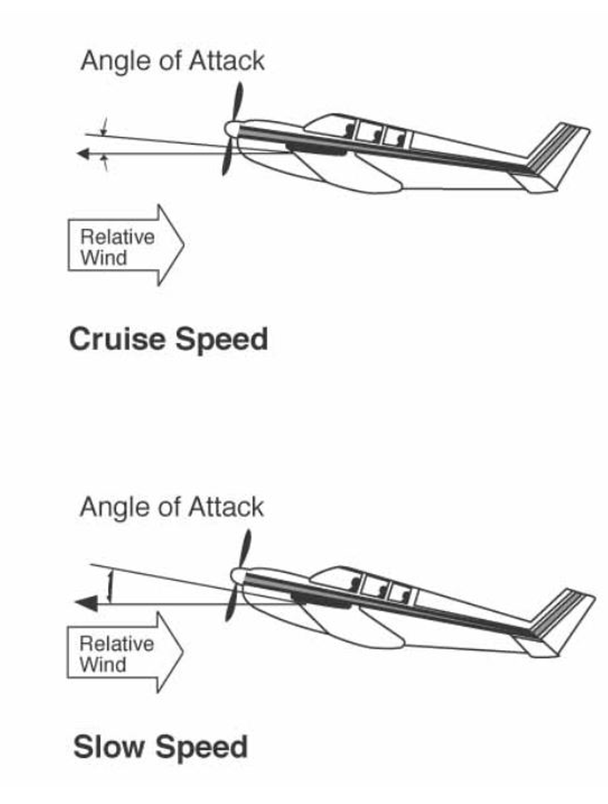
AOA and Phases of Flight
Different “Angles of Attack”
  Cruising phase (need ‘enough’ lift)
    Faster airspeed, Lower AOA
    Higher margin for a ‘stall’ event
  Climbing phase (need more Lift)
    Slower airspeed, Higher AOA
    More Lift, more drag
    Lower margin for a ‘stall’

Slide 6
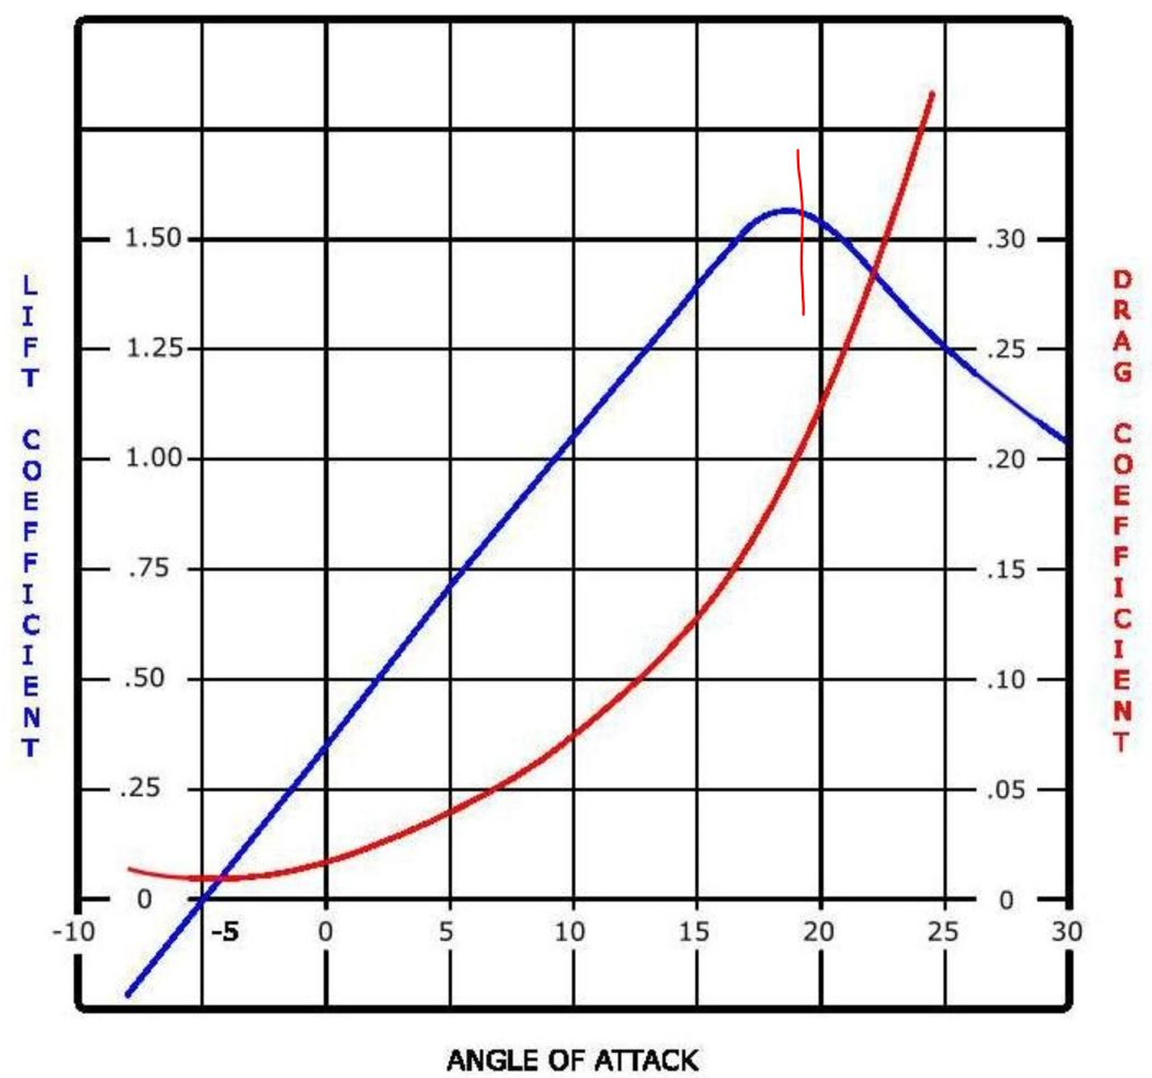

AOA versus Lift/Drag
Higher AOA means more Lift!!!
  (to a point, then...wow)
Higher AOA means more Drag
Critical Angle Of Attack
  Typically, 15-18degrees
  Lift drops dramatically, Drag increases dramatically

Slide 7
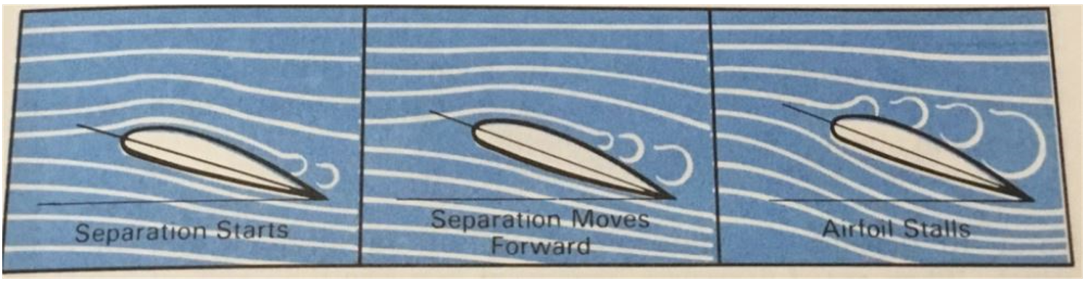
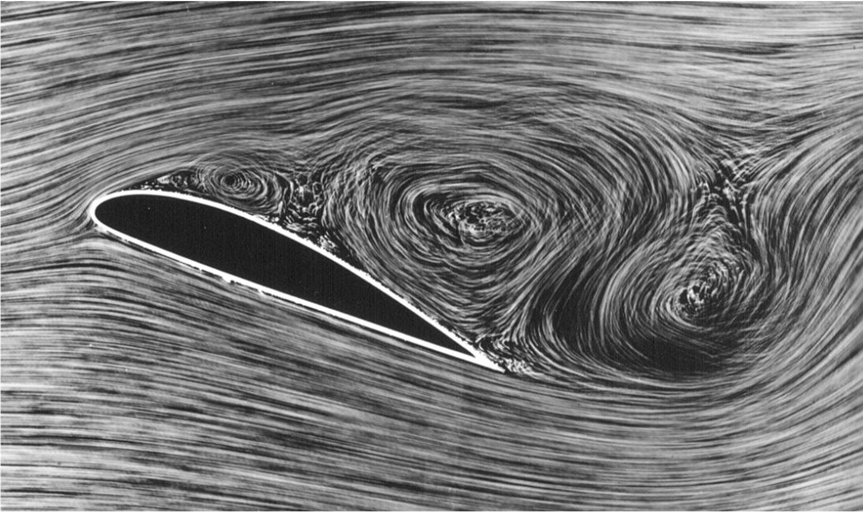
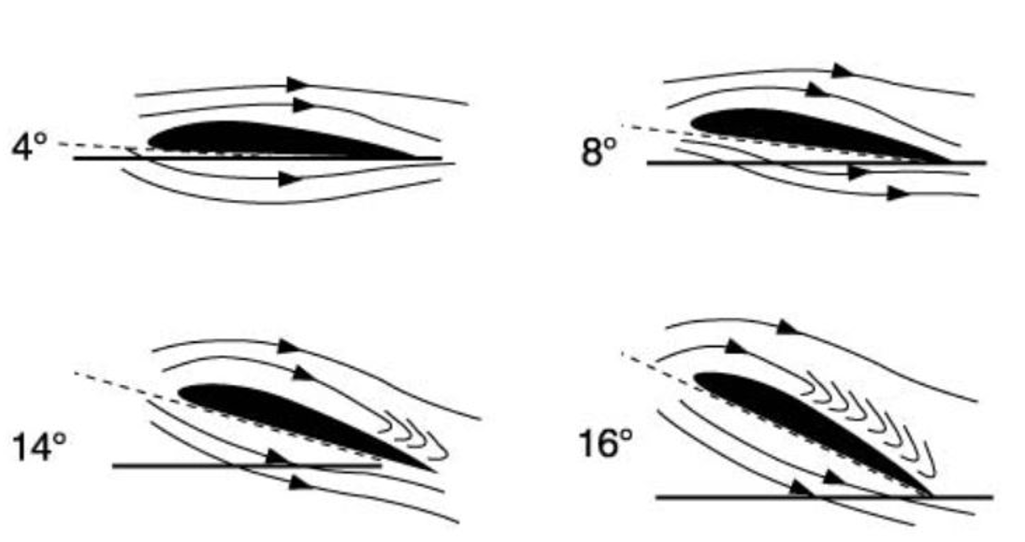
What Happens to the Wing
At critical angle of attack, airflow is no longer smoothly flowing over the wing
  Airflow becomes turbulent over the surface of the wing
  Stalling conditions begin from the rear of the wing and work forward

Slide 8
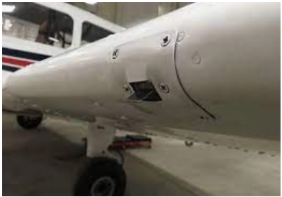
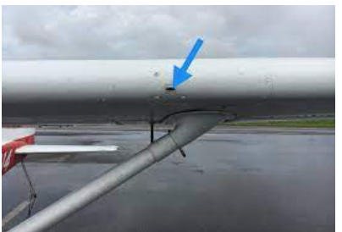
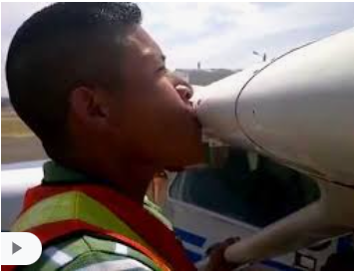


How to Detect a Stall
How to detect a Stall is about to occur
  Horn or Sensor indication inside the cockpit (horn/tab/AOA device)
  Recognizing slow airspeed
  Buffeting (from the turbulent air)
  Reduced noise of airflow
  Nose High attitude
  Inability to stop descending

Slide 9
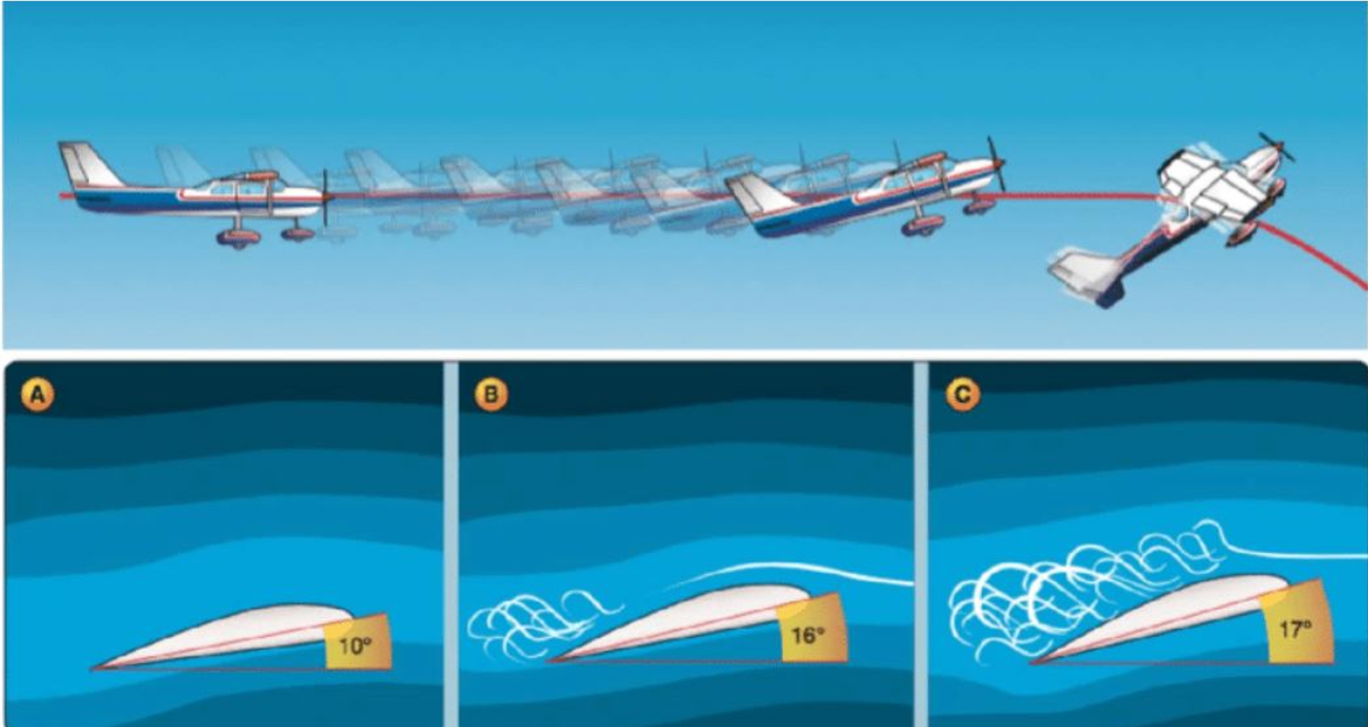
Just before the wings stall: “Stall about to Break”

Slide 10
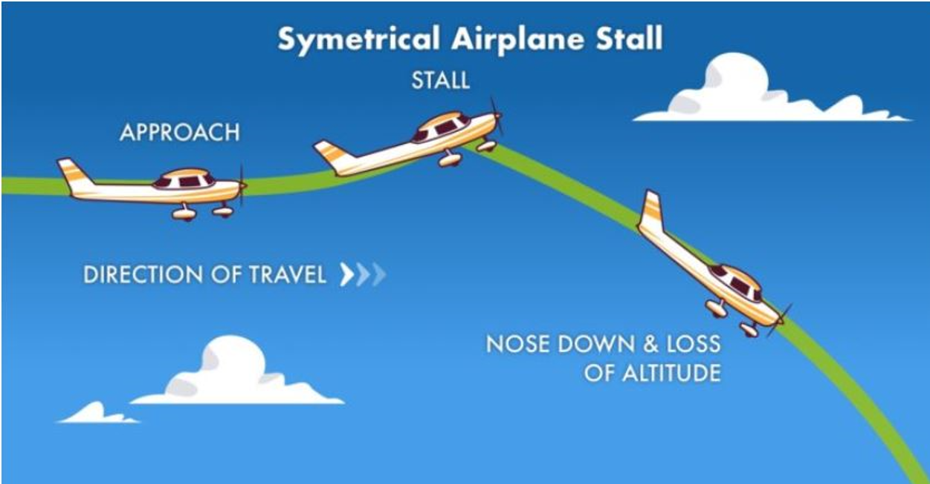
What Happens to the Airplane
Lift decreases quickly
Center of Gravity (CG) is in front of the Center of Lift (CL)
Nose will drop and aircraft begins rapidly descending

Slide 11
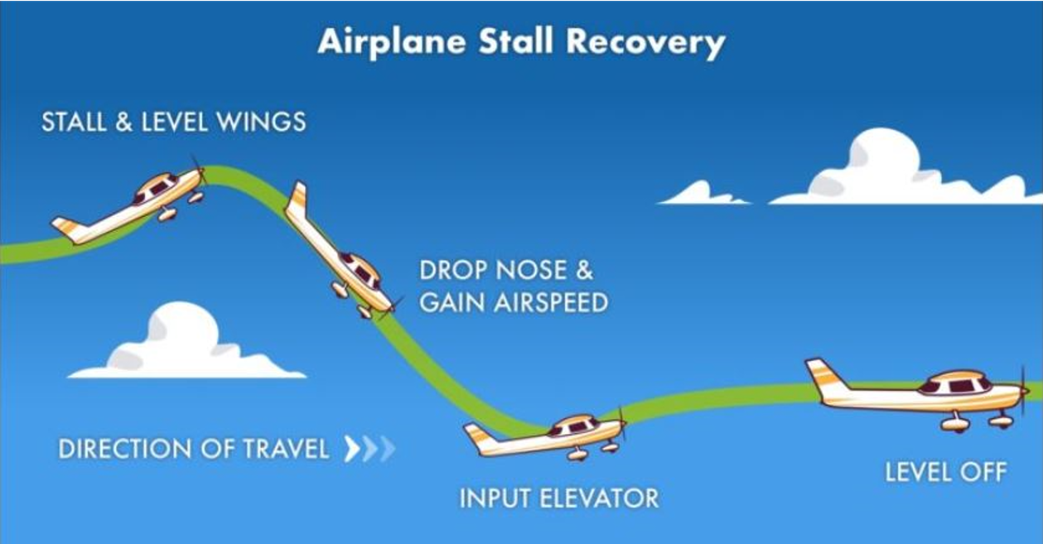
Recovery from a Stall
Step 1: REDUCE THE ANGLE OF ATTACK (it is that simple)
  YES: this means push forward, nose down, reduce the AOA
  NO: “Airplane is descending, I should pull back”
Increase airspeed ( add power)
Begin to level off (nose up)
Resume climb or cruise

Slide 12
Performing a ‘Stall’ (training)
We Practice Practice Practice... Stall Entry and Recovery
<Stall Video>
  https://www.mattbeyer.com/private/mdb/misc/CoffeeTalk/StallSpin/Matty1-Stalll.mp4

Slide 13
When Can a ‘Stall’ Occur
Can occur in any phase of flight
Most Common situations:
  Takeoff: High AOA, slow airspeed, pilot distractions, want to climb fast
  Landing: Low airspeed, pilot distractions (high workload)
    Pilot pulls back (increases AOA) to ‘stretch the glide to the runway’
Stall recovery in the above scenarios is difficult
  Insufficient altitude to recover (~50-200ft typically needed)

Slide 14
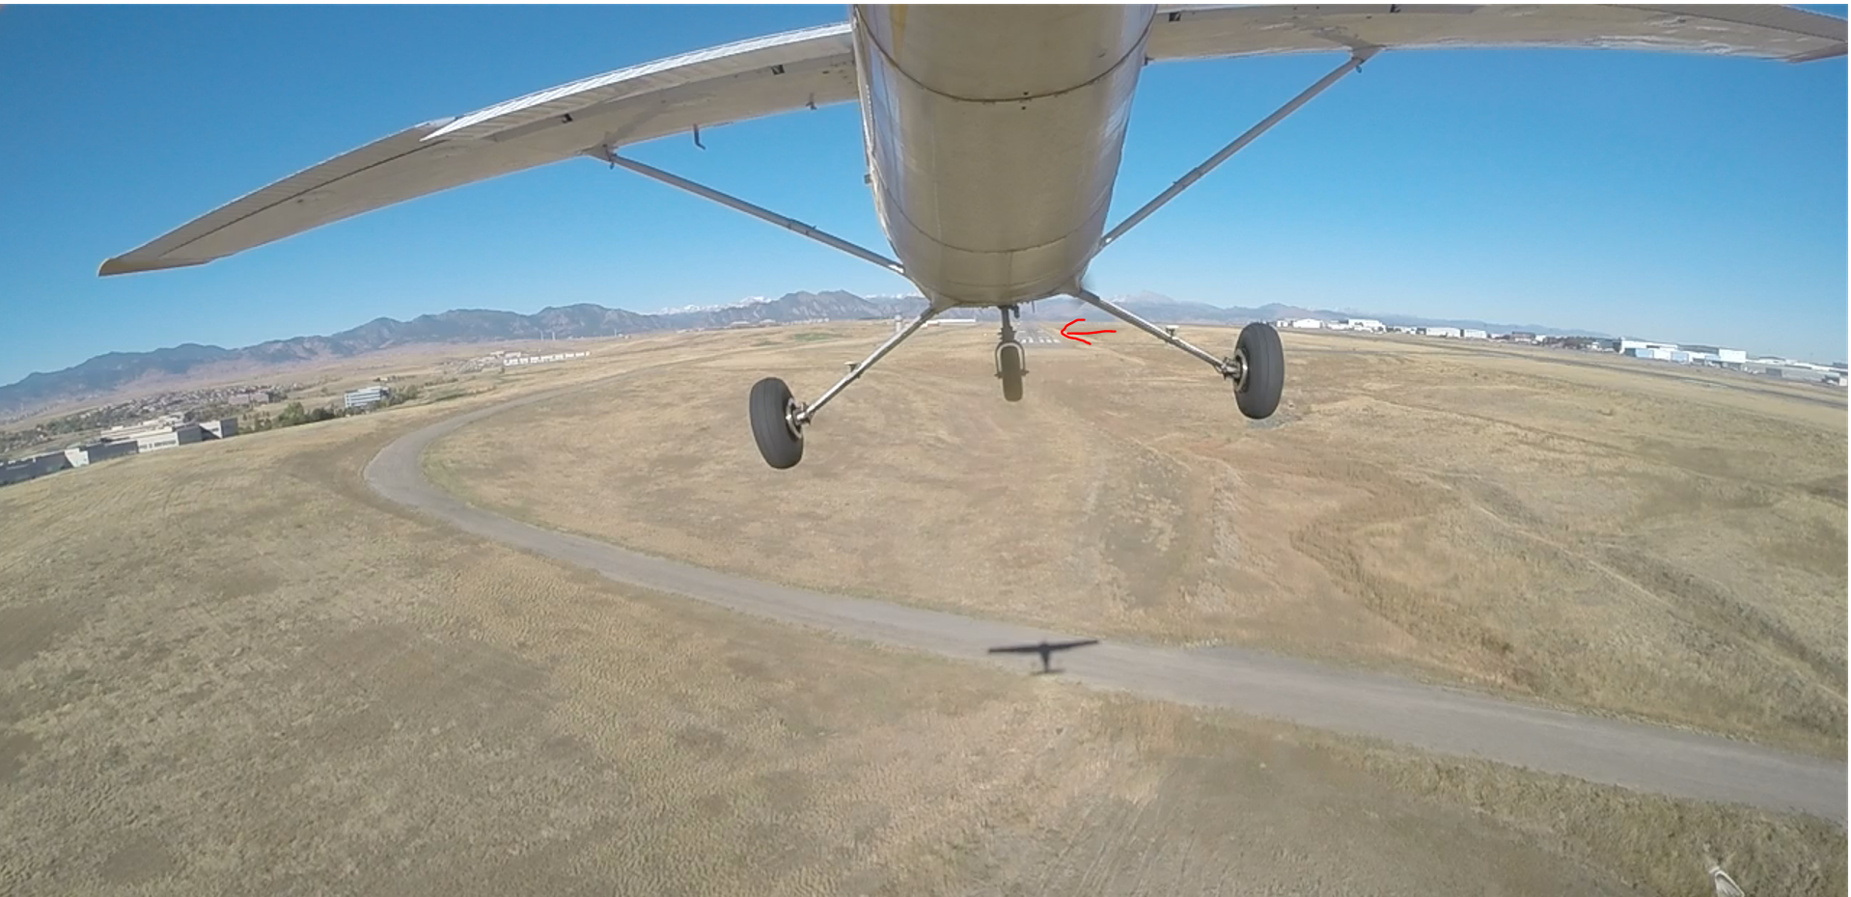
On Landing: ‘too low’ on final approach
My student is too low on final approach to runway
  Tendency to ‘lift the nose’ to ‘stretch it’
  Can lead to a stall at low altitude and....land short of the runway ☹

Slide 15
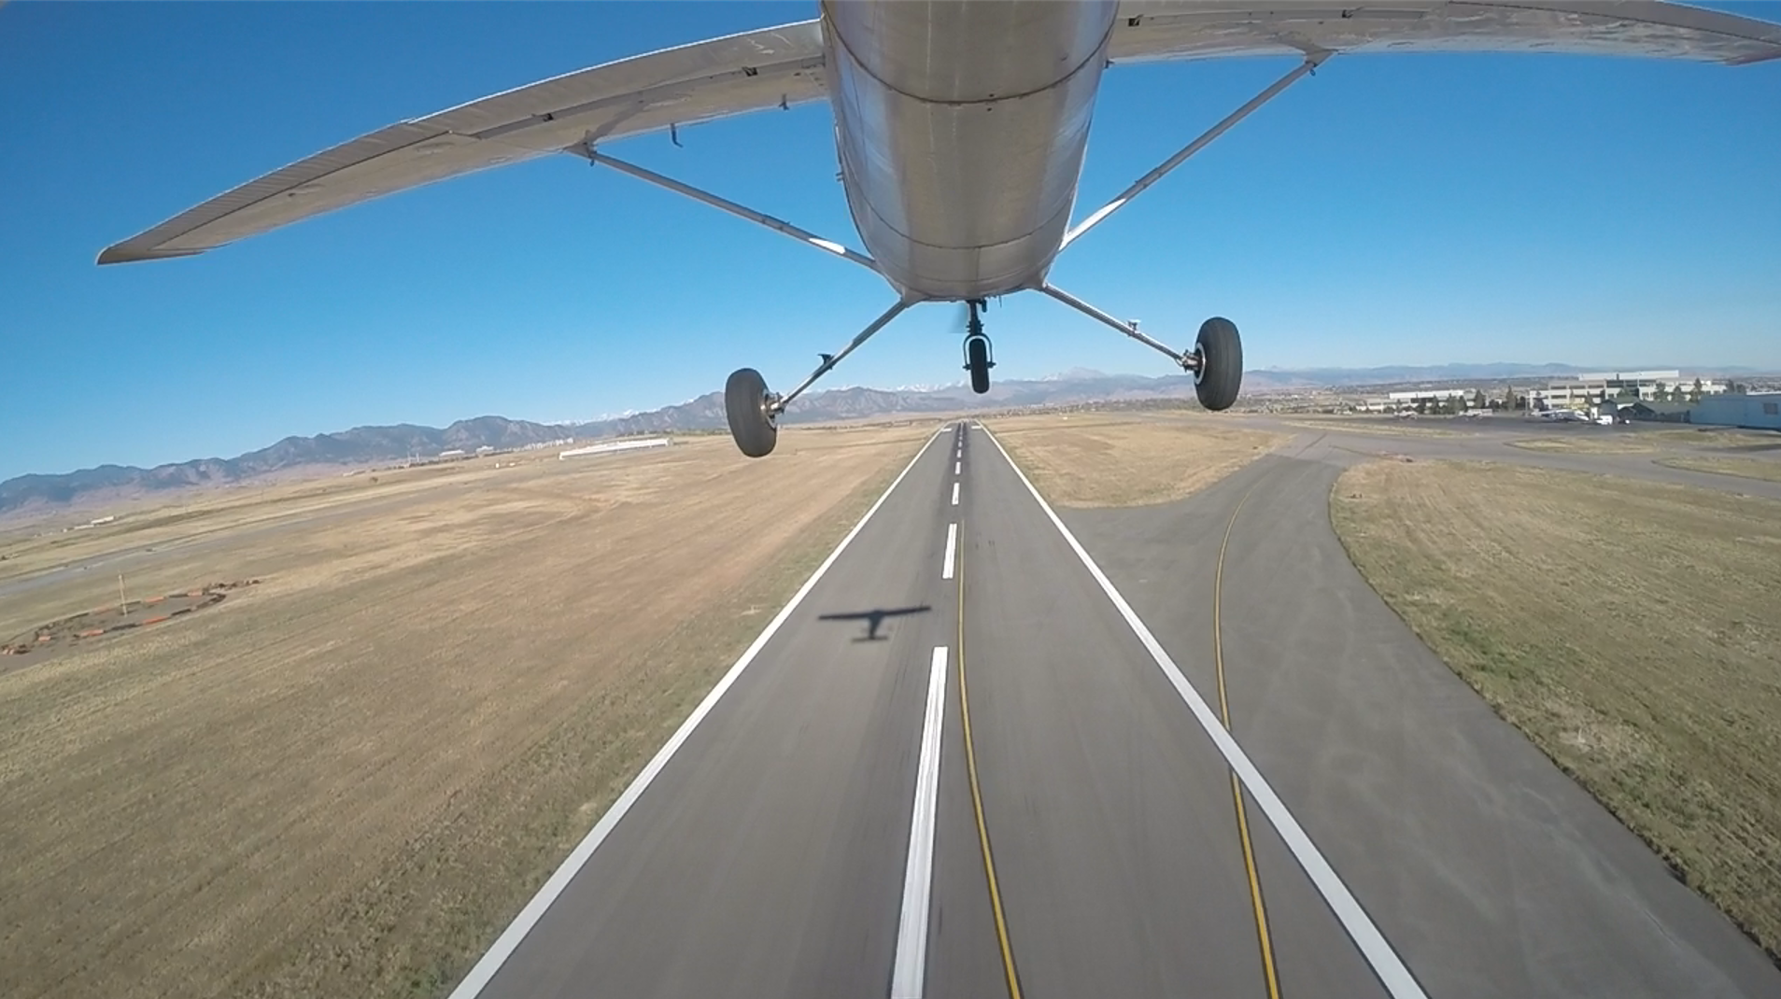
Stall possibilities on Takeoff
Tendency to “Need to Climb fast and get out of here”
  Can lead to a stall at low altitude (nose high, high AOA, slow speed)

Slide 16
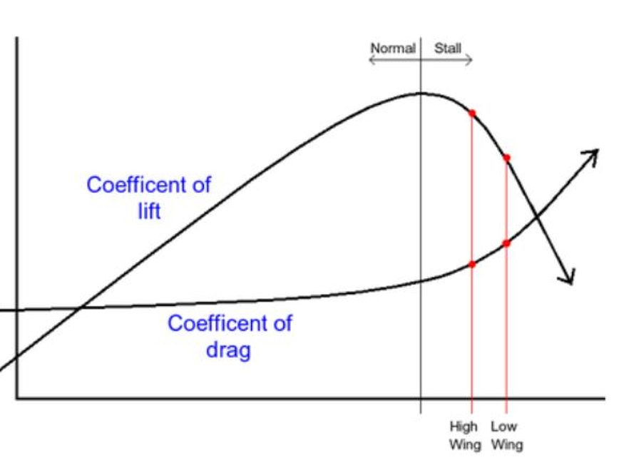
What Happens if Wings are not stalled Equally
Back to the AOA chart, what happens if ‘unequal positions on the chart”?
  One wing is ‘more stalled’ than the other.’
  What do we think would happen?

Slide 17
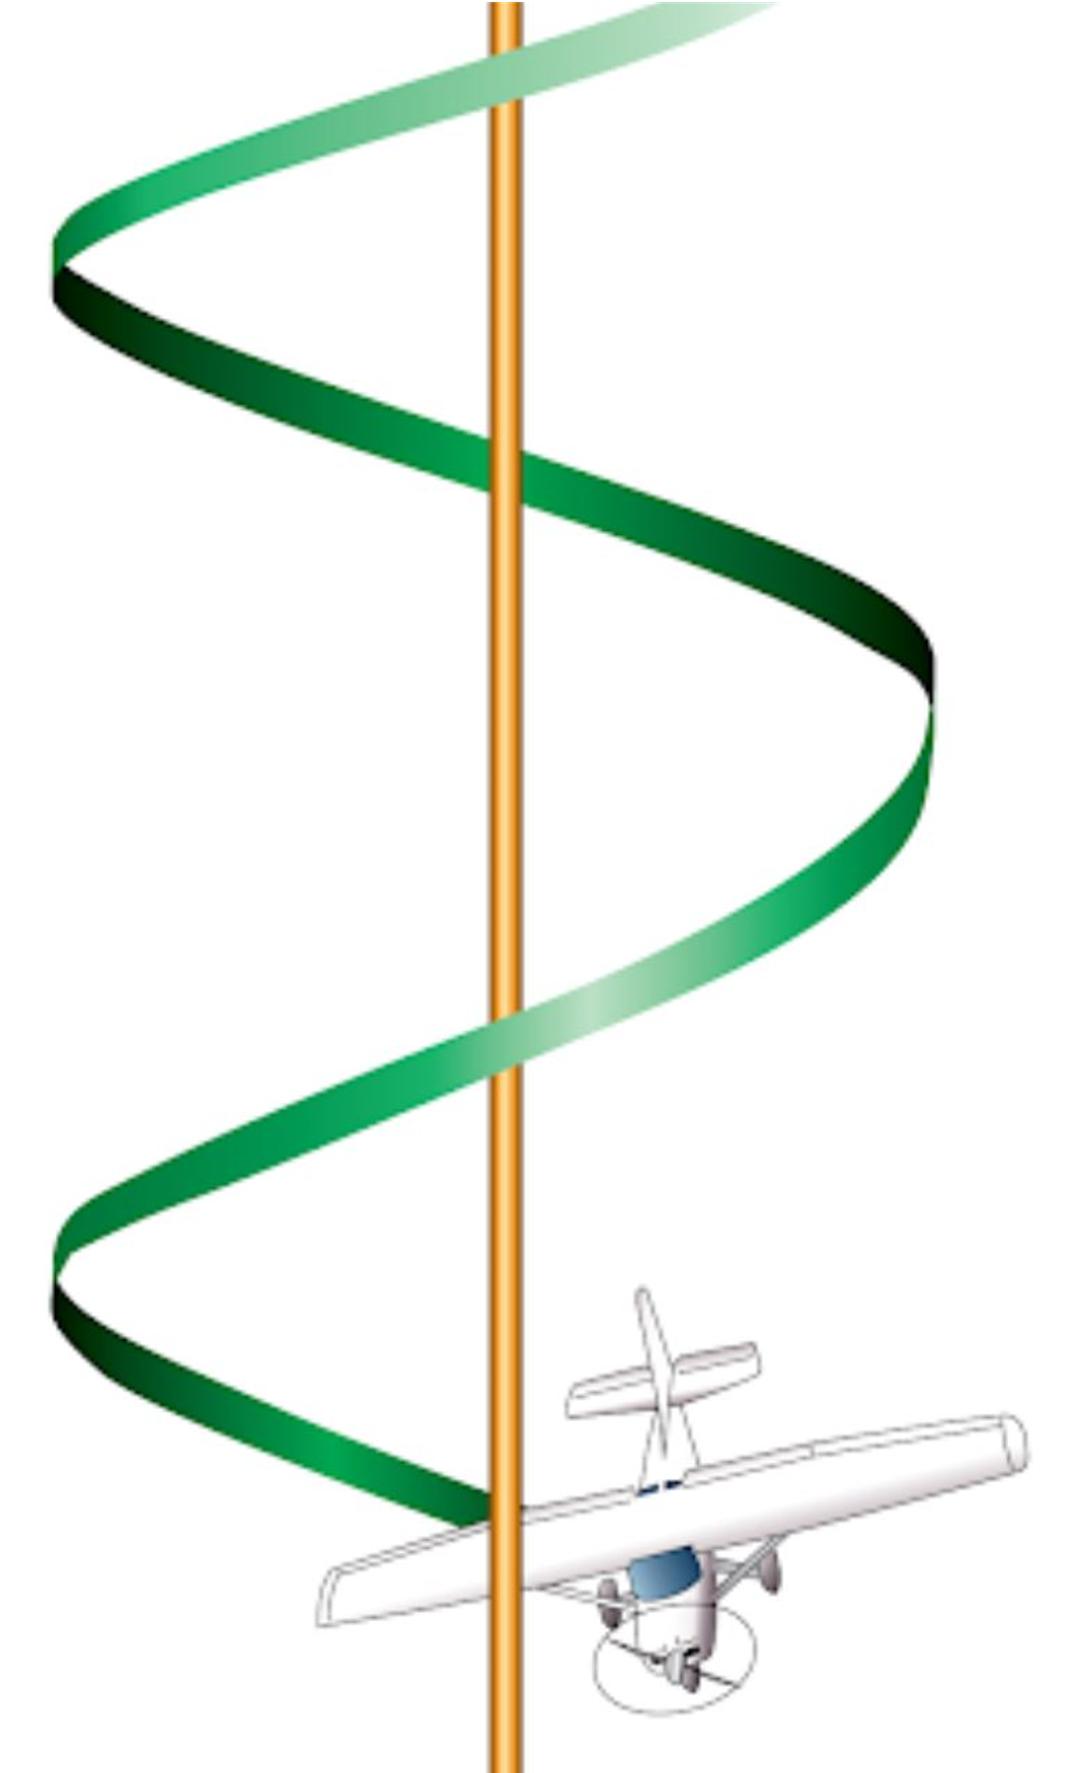
Stalls can become ‘Spins’
A spin can occur “Both wings are stalled”, but...
  But one wing is stalled more than the other
  One wing is generating more lift
    Creates an ‘auto-roll’
  The other wing is generating more drag
    Creates an ‘auto-yaw’
  Stalling, Rolling, Yawing all together

Slide 18
Training for ‘Spins and Recovery”
Spin training is required to become a Certified Flight Instructor
<video1>
  https://www.mattbeyer.com/private/mdb/misc/CoffeeTalk/StallSpin/Matty2-Spin.mp4
<video2> 3 rotations
  https://www.mattbeyer.com/private/mdb/misc/CoffeeTalk/StallSpin/Matty3-Spins3Turn.mp4
(Now its ok to drink your coffee while safely on the ground)

